Slide 1
WorkOne Indy Service Provision
Bidders’ Conference
March 14, 2023

Slide 2
Our Vision
All Indianapolis residents connect to the services + training necessary to achieve economic prosperity + grow in a career that meets employer demand for talent.
Our Mission
EmployIndy guides the local workforce ecosystem + makes strategic investments in partners focused on underserved + underrepresented residents.

Slide 3
Agenda
Welcome and introductions
System Overview
Purpose of RFP
Proposal Requirements
RFP Timeline
Technical Assistance

Slide 4
EmployIndy
EmployIndy guides the local workforce ecosystem and makes strategic investments to remove barriers to quality employment for underserved and underrepresented residents.

Slide 5
Address Systematic Barriers
Strategic Partnerships
Labor Market Information
Work-and-Learn Opportunities
Hiring Events
Workshops
Direct Hiring Assistance
Rapid Re-Employment

Slide 6
System Overview
Workforce Innovation and Opportunity Act (WIOA)
Public Law 113-1128 – July 22, 2014
Administered at Federal level by U.S. Department of Labor (DOL)
State Department of Workforce Development (DWD)
Local Workforce Development Board (WDB) - EmployIndy

Slide 7
EmployIndy
Workforce Development Board in Marion County.
Oversees and implements multiple federal, state, and local workforce development activities.
Non-profit with Board of Directors appointed by local government.
Departments
Business Partnerships
Talent Solutions
Neighborhood
Career Services
One Stop Operator

Slide 8
One-Stop Operator
Thomas P. Miller & Associates (TPMA)
Workforce Ecosystem Coordinator
Guiding investments and refinements of Marion County workforce development system.
Building relationships across stakeholders and sectors to improve efficacy of the ecosystem.

Slide 9
TPMA & WorkOne Service Provider
Expected to actively participate in improving efficacy of the local workforce system.
“Ecosystem” used to reinforce reality that meeting diverse needs of job seekers and employers requires healthy interaction between a community of partnering entities.
TPMA hosts Ecosystem Enrichment once a month and all service provider staff participate along with community and WIOA partners.

Slide 10
WorkOne Indy
Single comprehensive center at 4410 N Shadeland Avenue
Potential to embed Career Navigation at community partner locations.
Wednesdays@WorkOne
Workshop Development and Facilitation
Potential to offer community based workshops

Slide 11
Purpose of RFP
Contract to provide comprehensive WorkOne Indy Services to Adult, Dislocated Worker, and Out-of-School Youth in Marion County.
Provide basic, individualized, and follow-up workforce development services within the WorkOne Indy System.
Implement workforce development efforts in coordination with EmployIndy teams and other partners.

Slide 12
Scope of Work
Service Area
Marion County
Hours of operation, regular business days and other hours to accommodate need as set by EmployIndy
Each Career Navigator may embed one day in a community location as set by EmployIndy
Office, equipment and supplies are typically provided by EmployIndy. Specific needs should be outlined in the Budget template.

Slide 13
Data Review
2023 Data
Phone calls in/out
Workshop attendance
Referrals in to WorkOne Indy
Activities in the buidling

Slide 14
Responsibilities
WIOA activities including basic, individualized and follow-up services
Functional management of DWD State Staff located in comprehensive sites
Coordinate services with partners
Quality Assurance

Slide 15
Staffing
Expected staff knowledge and skills:
Communication skills
Multicultural Competency
Knowledge of Career Pathways for INDemand Jobs and current Labor Market Data
Job Readiness
Timely documentation & reporting
Empathy
Openness
Problem solving skills
Focus on building a “talent pipeline”

Slide 16
Acceptable Titles
For response to the RFP the titles should be limited to the following:
Program Director
Quality Assurance Manager or Specialist
Operations Supervisor or Team Lead
Career Navigator
Workshop Facilitator

Slide 17
Contract & Funding
WIOA funds
Up to $1,900,000 for 12 month period
July 1, 2023 thru June 30, 2024
Option to extend for up to 3 years through June 30, 2027
Transition period may be established
All staff must be hired and in place by May 31, 2023

Slide 18
RFP Timeline
Activity | Deadline
Deadline to submit questions | March 17, 2023, 5:00 p.m. ET
Response to questions posted | March 21, 2023
Proposals due | March 31, 2023, 5 p.m. ET
Bidders Presentations if needed | Week of April 10, 2023
Notice of award | Week of April 24, 2023 (per board approval)
Contract negotiation period | May 1, 2023 – May 30, 2023
Effective date of contract | July 1, 2023; June 1, 2023 for transition

Slide 19
Proposal Requirements
Must follow the outline
Must include all section and sub-section headings exactly as they appear in the RFP
Must include all proposal details within maximum page limits for each section

Slide 20
Proposal Outline
Proposal Cover Sheet – use template provided in RFP Attachment 2 (max one page)
Organizational Capability and Qualifications (max 3 pages)
Service Delivery Plan (max 12 pages)
Quality Assurance Plan (max 3 pages)
Budget Summary Form – use template provided in RFP Attachment 3 (max 1 page)
Budget Narrative (max 2 pages)
Required Attachments (6 attachments)

Slide 21
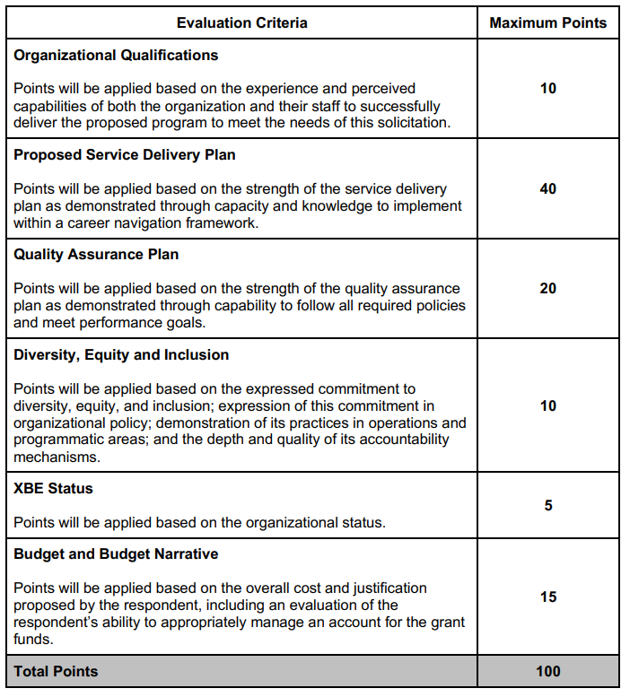
Scoring Rubric

Slide 22
Technical Assistance
Record each question in the comment section of virtual meeting and include name and organization
Additional questions must be submitted at www.employindy.org/contractopp
All responses posted at employindy.org

Slide 23
Additional Resources
EmployIndy.org
WorkOneIndy.com
Indianacareerready.com
Indianacareerexplorer.com
Indianacareerconnect.com

